Slide 1
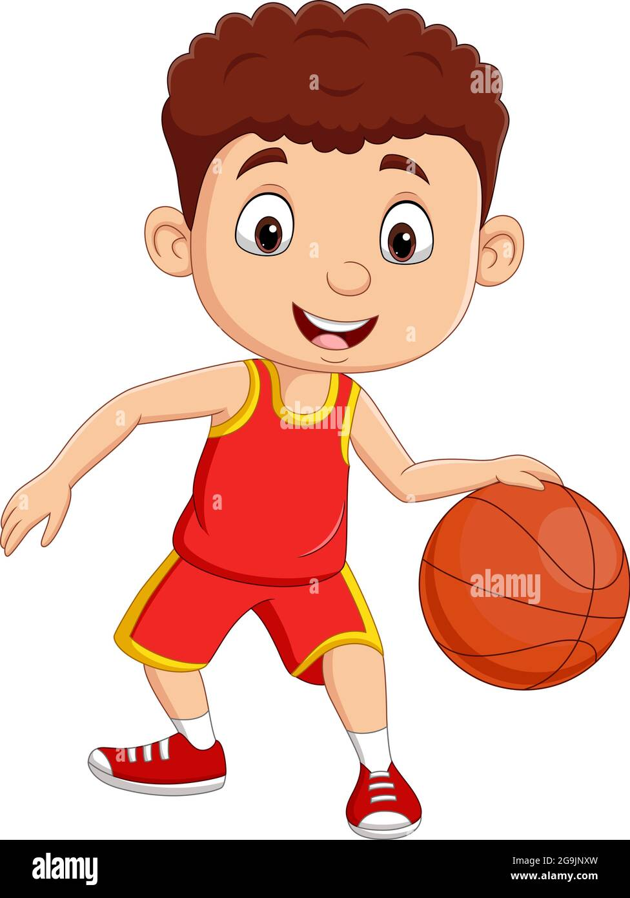
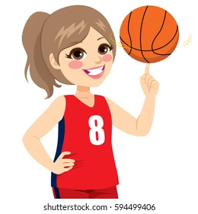
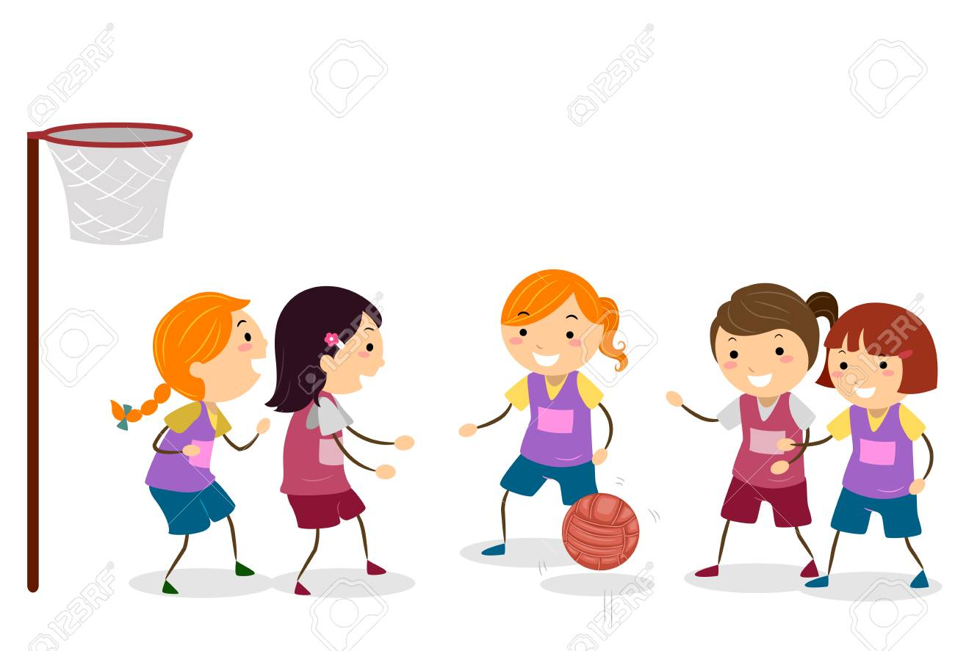
PE Clubs
Oct – Dec Half Term
Year 7 and 8 Basketball Club KHA
Every Tuesday in Gym
3pm – 4pm
Year All Year Groups Rugby Club - RST & LSU
Every Monday
Boys & Girls = School fields so Bring Boots!
3pm – 4pm
Yr 9, 10 and 11 Basketball Club RST
Every Thursday in Gym
3pm – 4pm
All Year Groups - Table Tennis Club CJA
Every Monday* 7Nov Start in School Hall
3pm – 4pm
Year 7 – 11 Girls Netball Club VWA & CFO
Every
Tuesday
3pm – 4pm
Leadership Academy – CJA
Yr 9 Only Thursday
Yr 11 Social Football CJA
Friday
Girls Social Fitness – CFO/VWA
All Year Groups - Friday
Staff Fitness/Wellbeing
Thursday
*Basketball training will stop early when mock exams take place at the end of November.
8am Coursework Support – Tuesday - CJA ICT4
Please bring your PE kit and change at the end of the school day if you are going to take part in a club!

